Slide 1
State Assessment Changes
Accessibility Features and Designated Supports

Slide 2
Session Objectives
Content Objective
Today I will explore different designated supports available for ELLs on state assessments.
Language Objective
Today I will share with my peers one designated support and I will listen to their presentations.

Slide 3
STAAR Assessments
STAAR
STAAR
Spanish
STAAR
Alternate 2
Paper or online
Paper
Online

Slide 4
Assessment Accommodations
3. Designated Supports (w/TEA approval)
2. Designated Supports (w/local approval)
1. Accessibility Features (all students)

Slide 5
1. Accessibility Features

Slide 6
1. Accessibility Features
#1
#2
#3

Slide 7
2. Designated Supports
STAAR, STAAR Spanish, and TELPAS accommodations:
Description of Accommodation
Assessments
Student Eligibility Criteria
Authority for Decision and Required Documentation
Examples/Types
Special Instructions/Considerations

Slide 8
2. Designated Supports
Basic Transcribing | Braille | Large Print | Spelling Assistance
Amplification Devices | Manipulating Test Materials | Oral/Signed Administration | Calculation Aids
Dictionary | Extra Time | Content Supports | Mathematics Manipulatives
Projection Devices | Individualized Structured Reminders | Language and Vocabulary Supports | Supplemental Aids
OA, content, and language and vocabulary supports are embedded in the STAAR online interface.

Slide 9
2. Designated Supports
Content Supports
Dictionary*
Extra Time*
Language and Vocabulary Supports*
Oral/Signed Administration*
Basic Transcribing
Large Print
Amplification Devices
Manipulating Test Materials
Mathematics Manipulatives
Projection Devices
Individualized Structured Reminders
Supplemental Aids
Some of these designated supports are not new to the assessment program, but are NEW FOR LPACs.
Sometimes these decisions are done in conjunction with other committees.
*If given for R/W, student may not exit LEP status

Slide 10
2. Designated Supports
Content Supports
Dictionary*
Extra Time*
Language and Vocabulary Supports*
Oral/Signed Administration*
*If given for R/W, student may not exit LEP status

Slide 11
1. Content supports

Slide 12
Content Supports
This pop-up isolates information that corresponds to each answer choice.

Slide 13
Content Supports
This pop-up isolates information that corresponds to each answer choice.
NOT only for ELLs in their first three years in the U.S. anymore!

Slide 14
Content Supports
This pop-up isolates information that corresponds to each answer choice.
STAAR Online brings
Content Supports and Language/Vocabulary Supports in ALL SUBJECTS, including Reading and Writing

Slide 15
Content Supports
This pop-up isolates information that corresponds to each answer choice.
As long as the students are receiving this kind of support in the classroom (not necessarily on a computer), the LPAC may recommend these supports for testing.

Slide 16
Content Supports
This pop-up also isolates information that corresponds to each answer choice.

Slide 17
Content Supports
This is another example of a pop-up that isolates information that corresponds to each answer choice.

Slide 18
Content Supports
This pop-up provides a formula from the reference material.

Slide 19
Content Supports
This pop-up provides a supplemental aid
(i.e., map).

Slide 20
Content Supports
This pop-up provides a visual representation (i.e., photograph) of a historical figure.

Slide 21
Content Supports
This is a supplementary material. Blank Punnett squares are available for a student to use on STAAR biology with Content Supports.

Slide 22
2. dictionaries

Slide 23
Dictionaries
LPACs should be very familiar with information about eligibility and allowable types of dictionaries for this designated support: http://tea.texas.gov/student.assessment/accommodations/
LPACs should also be very familiar with the updated STAAR dictionary policy for all students, which is available on TEA’s STAAR Reading Resources webpage: http://tea.texas.gov/student.assessment/staar/reading/
Remember! The use of bilingual dictionaries can now be found under the accessibility features (Math, Science and Social Studies). Their use DOES NOT have to be documented by the LPAC:http://tea.texas.gov/student.assessment/accommodations/

Slide 24
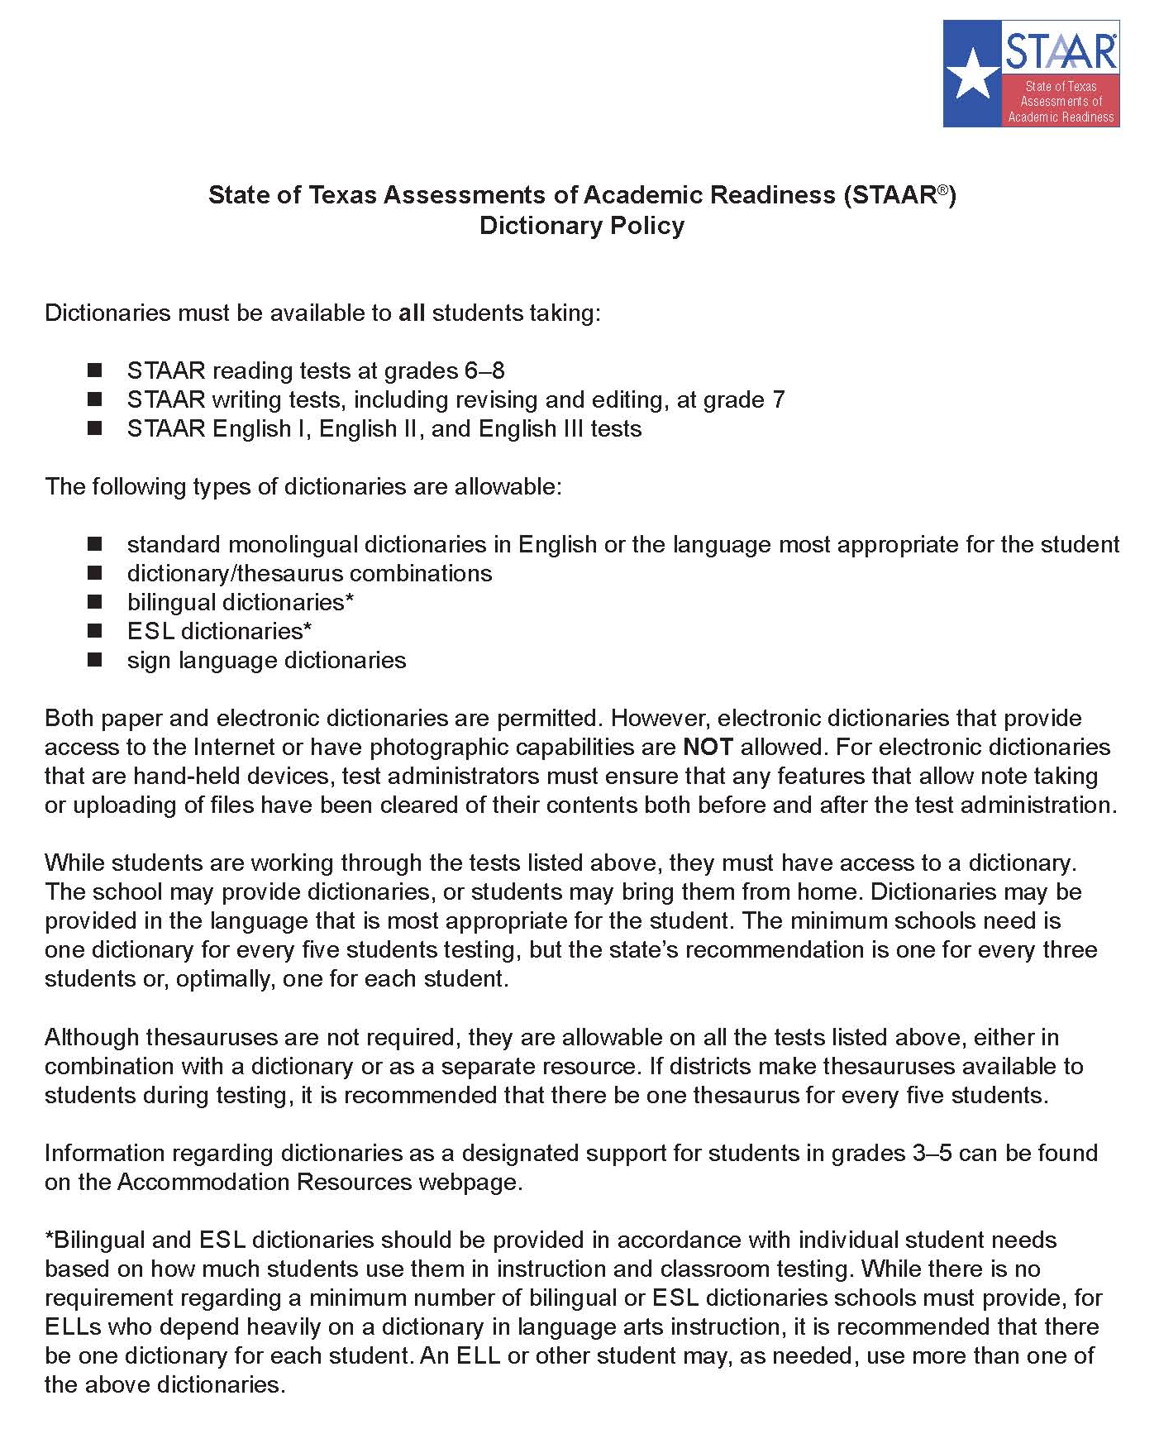
Dictionaries

Slide 25
Dictionaries

Slide 26
3. Extra time

Slide 27
Extra Time
Routine use in specified contexts: ELL must need and routinely be provided extra time when completing assignments and assessments that require substantial comprehension or use a substantial amount of English.
Second language acquisition needs: An ELL’s need for extra time must be based on second language acquisition factors related to the time the ELL needs to read meaningfully in English or write a meaningful response, as applicable.
Non-factors: Factors that are not ELL-specific must not be considered, such as test anxiety, use of test strategies, or other reasons not related to second language acquisition.
NOT an automatic decision!

Slide 28
4. Language and vocabulary supports

Slide 29
Language and Vocabulary Supports
This pop-up provides a visual representation (i.e., photograph) of the vocabulary.

Slide 30
Language and Vocabulary Supports
NOT only for ELLs in their first three years in the U.S. anymore!
This pop-up provides a visual representation (i.e., photograph) of the vocabulary.

Slide 31
Language and Vocabulary Supports
STAAR Online brings
Content Supports and Language/Vocabulary Supports in ALL SUBJECTS, including Reading and Writing
This pop-up provides a visual representation (i.e., photograph) of the vocabulary.

Slide 32
Language and Vocabulary Supports
As long as the students are receiving this kind of support in the classroom (not necessarily on a computer), the LPAC may recommend these supports for testing.
This pop-up provides a visual representation (i.e., photograph) of the vocabulary.

Slide 33
Language and Vocabulary Supports
This pop-up also provides a visual representation (i.e., art) of the language in a reading selection.

Slide 34
Language and Vocabulary Supports
These pop-ups clarify construct-irrelevant words.

Slide 35
Language and Vocabulary Supports
This rollover clarifies text using simpler and consistent language.

Slide 36
Language and Vocabulary Supports
Pre-reading text appears before all reading and writing selections.

Slide 37
5. Oral administration

Slide 38
Oral Administration
Oral Administration
Paper
Online
Text to Speech
Do not document levels
Test administrator
Document levels

Slide 39
Oral Administration
Oral Admin
Content Supports
STAAR Online
and/or
Language & Vocabulary Supports

Slide 40
What is the instructional impact of these changes?

